Slide 1
Status Review
29.01.2018

Slide 2
Last week:
Further work on Python and modelling script
Solved EES-related problems → Assume good guess values/boundaries
Changed pressure drop equations → very good outputs
Refilled IDC150 → test with demand defrost during the weekend

Slide 3
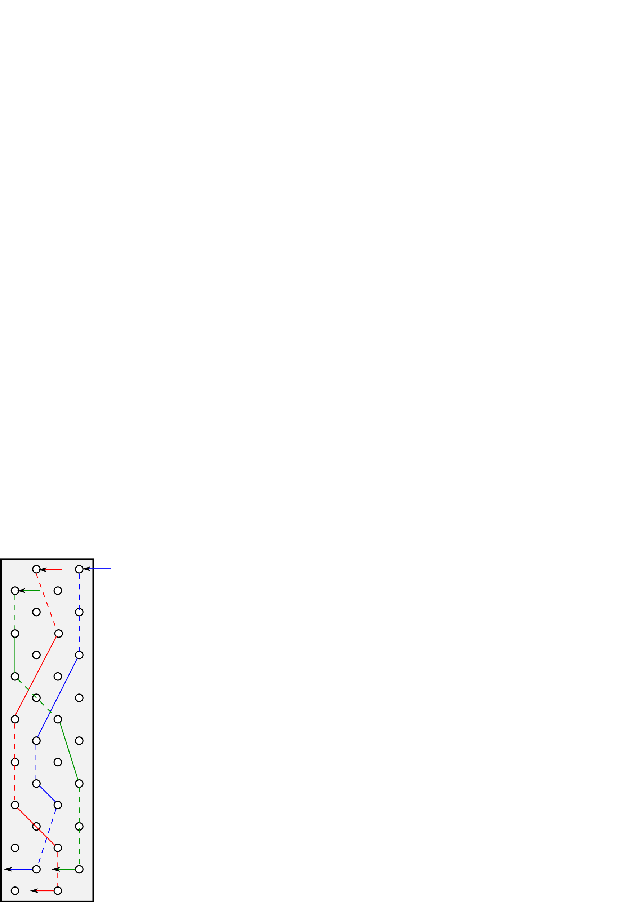
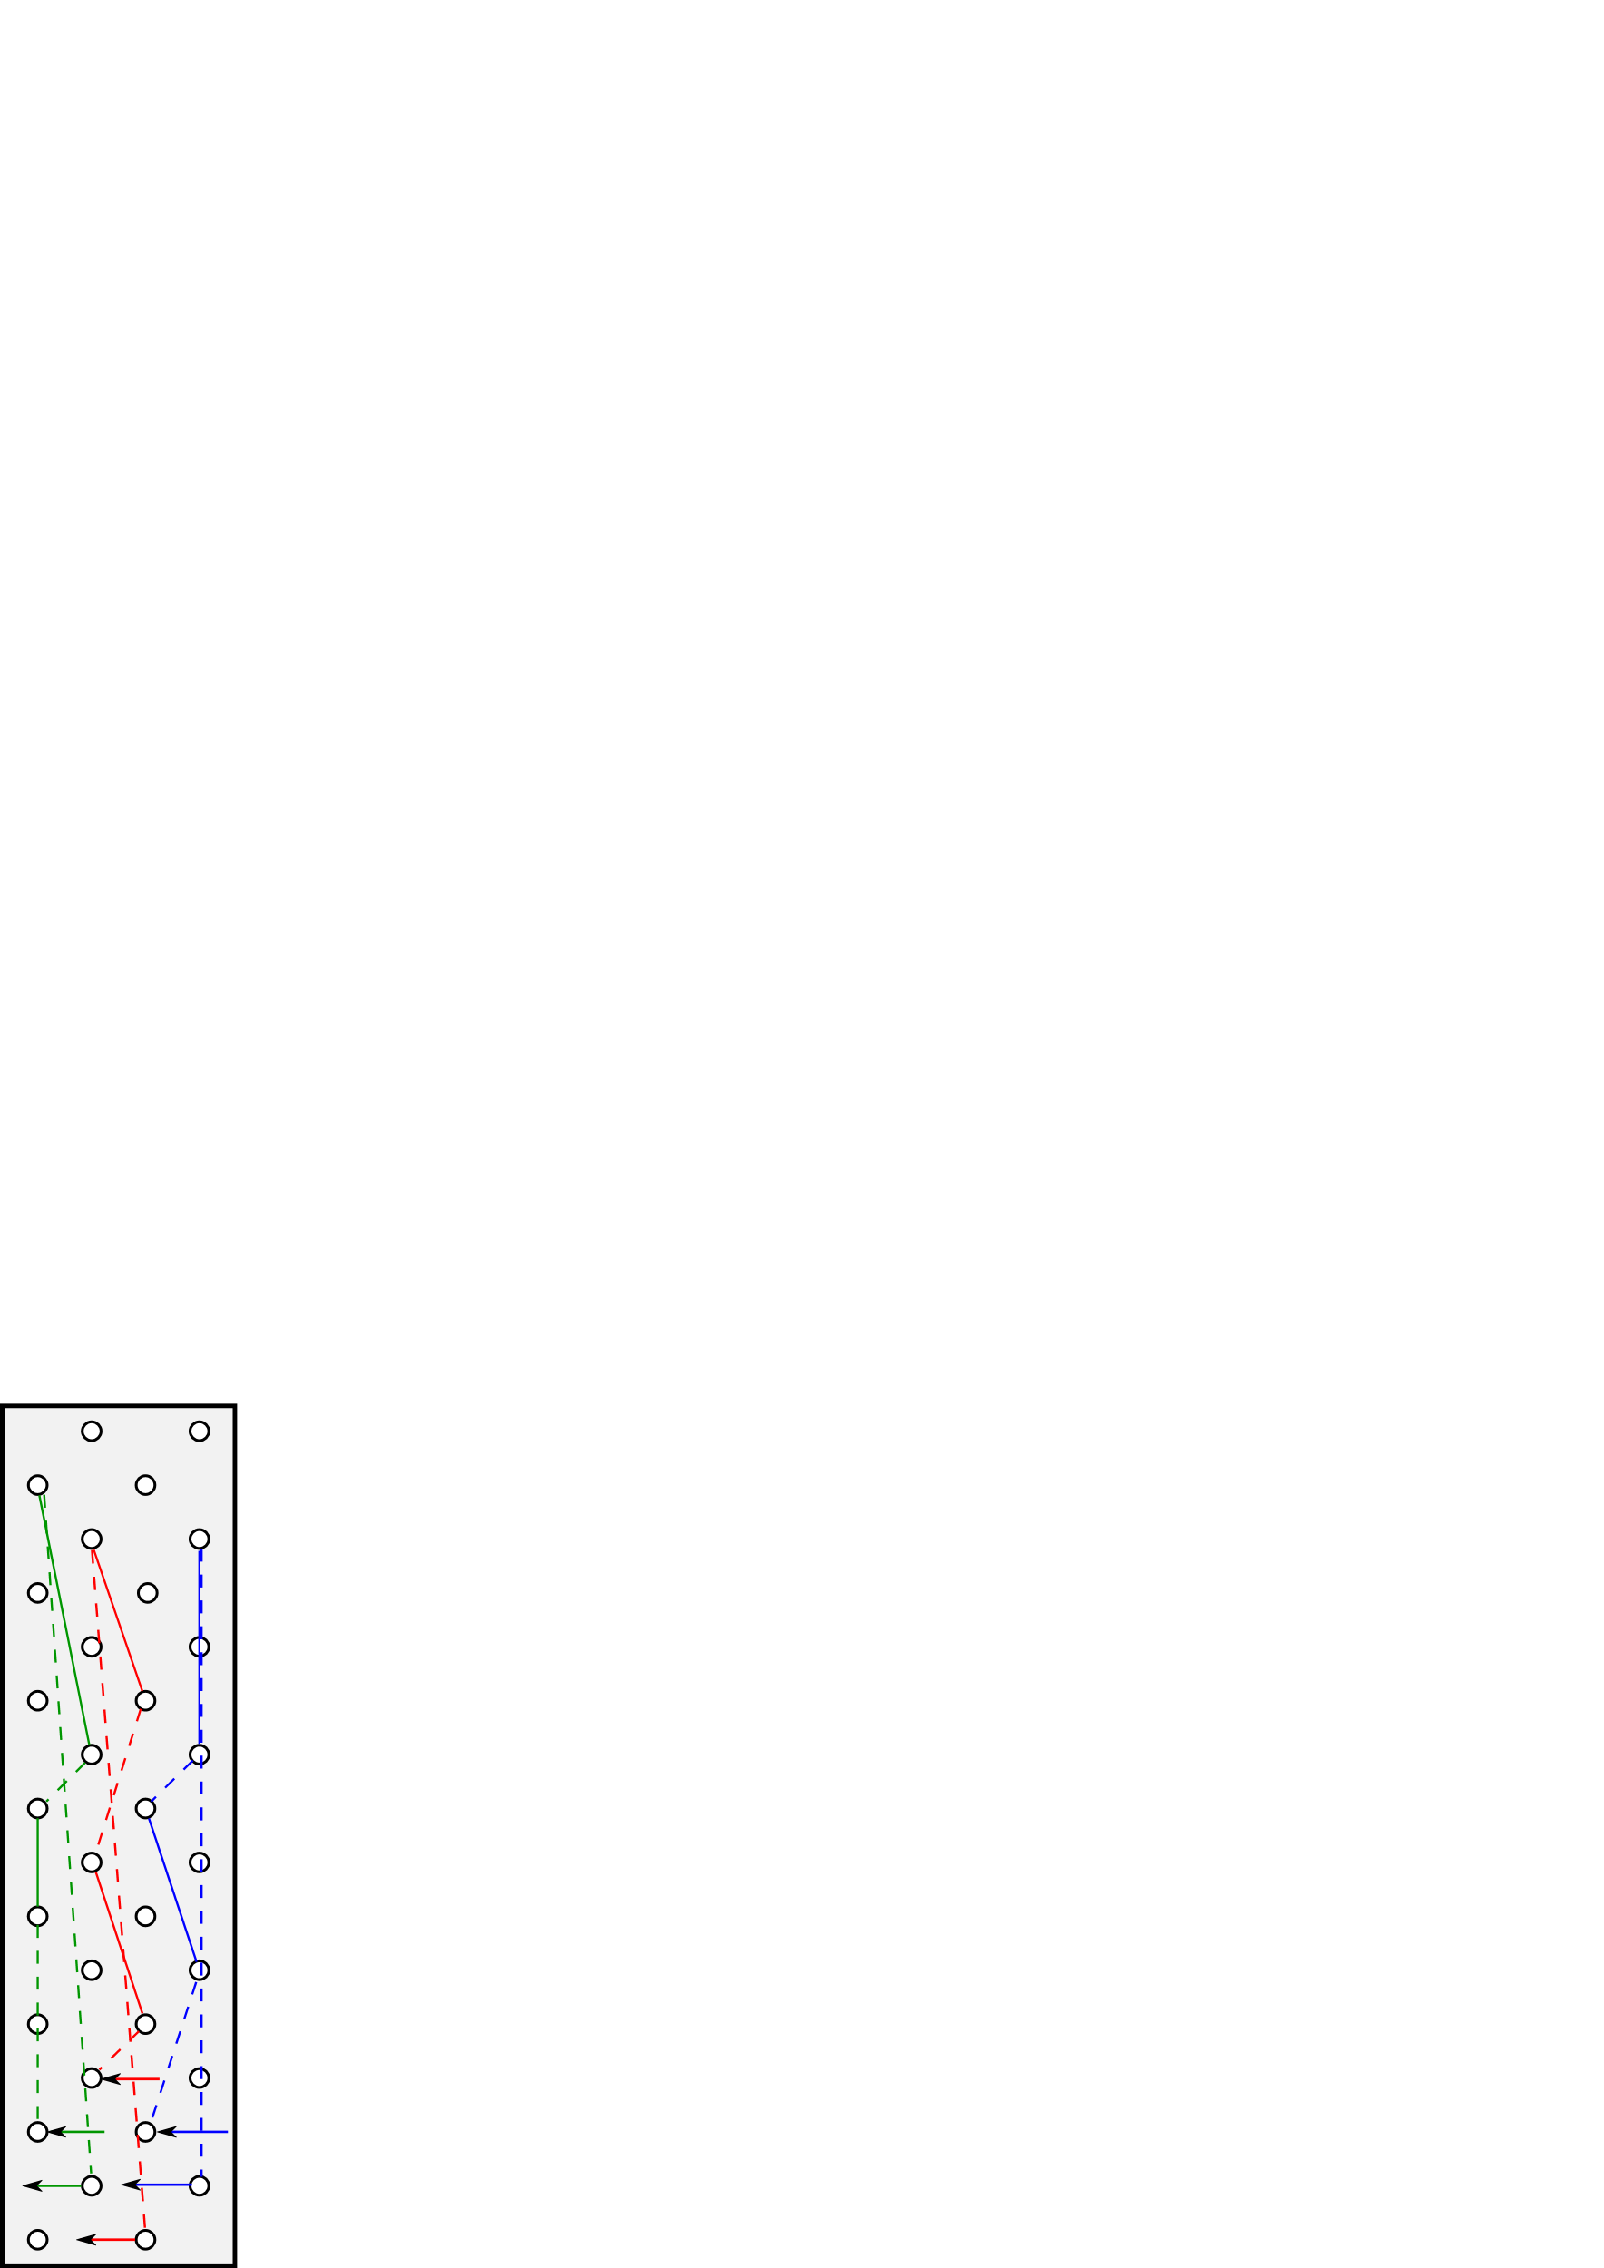
Coil arrangements
Evaporator Lidl-Design
Counterflow but performs like parallel flow
Evaporator Version 2
Mix of counterflow and parallelflow → bigger ΔT
Temperature
Temperature
ΔT
ΔT
Heigth
Heigth

Slide 4

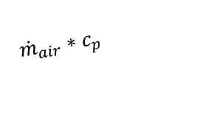
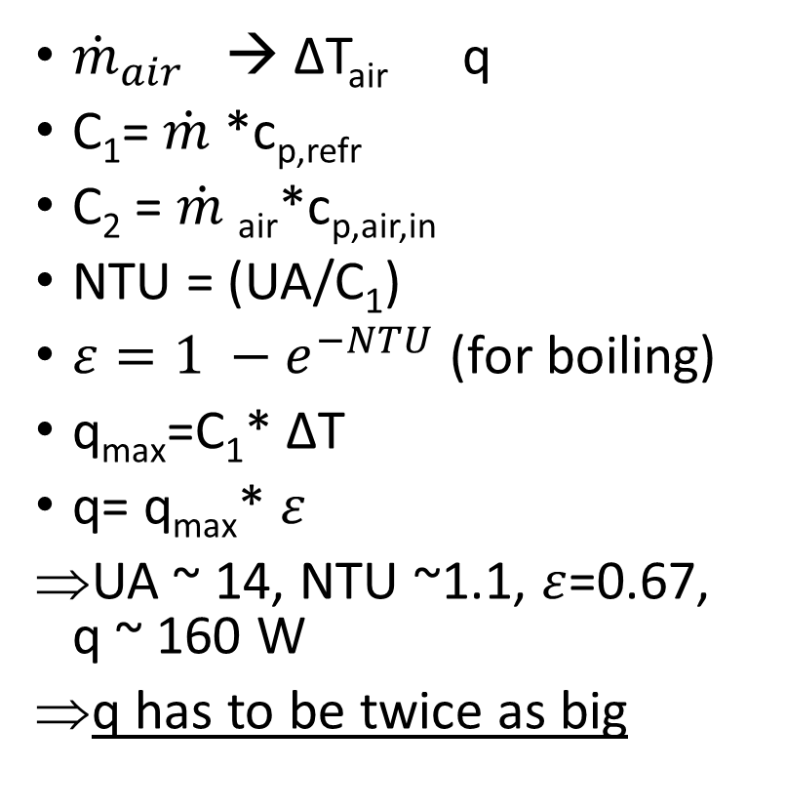
Problem in evaporator model
Cooling capacity too small → no Superheat, ΔT_{air} small
${\dot{m}}_{air}$ → ΔT_{air} q
C₁= $\dot{m}$*c_{p,refr}
C₂ = $\dot{m}$_{air}*c_{p,air,in}
NTU = (UA/C₁)
$ε=1 −e^{−NTU}$ (for boiling)
q_{max}=C₁* ΔT
q= q_{max}* $ε$
UA ~ 14, NTU ~1.1, $ε$=0.67, q ~ 160 W
q has to be twice as big
${\dot{m}}_{air}∗c_{p}$
ΔT_{air}
ΔT
Temperature
${\dot{m}}_{refr}∗c_{p}$
Heigth

Slide 5
To-Do:
Change evaporator

